Slide 1



A MINOR PROJECT PRESENTATION
ON
HOTEL ADMINISTRATE SYSTEM
Submitted By:
Soumen Pradhan
Suman Bar
Amit Ranjan Paria
Avijit Bera
Guide By:
Mrs. Paulami Basu Ray
Department of Computer Science &
Application
Prabhat Kumar College

Slide 2
To Whom It May Concern
This is to certify that Mrs. Paulami Basu Ray from Department of Computer Science and Application is help us to complete this project.
We also like to thank her for helping us in what ever way possible through their expert advices and encouraging us to go even deeper in the project.

Slide 3


Goals Of The Project
Book Hotel
About hotel
Managers manages room digitally
Admins can modify Application and Database

Slide 4
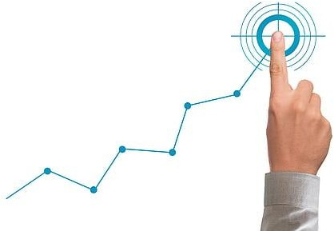

Objectives Of The Project
Using MySql Database to Store Data
A option for Employee to book hotel
A option to see available rooms
Better system to store current customer information
A option for automatic bill generate
Customer Details and Room booked details
searching system.

Slide 5





Feasibility Analysis
Technical Feasibility:
Easily runs in any computer.
Works eﬃciently on any hotel computer.
Long term support availability.
Operational Feasibility:
User Friendly user interface
Easy to teach by given user manual
Economical Feasibility:
Fills hotels budget requirement
Small cost on future update.

Slide 6



Functionality Of Users
Employee:
Books Room
Maintain Customer Details
Provide Hotel Service
Admin:
Maintenance
Application
Types of User
Employee
Manager
Admin
Manager:
Manages room
Checks out customer

Slide 7

Non Functional Requirements
Eﬃciency Requirements:
Eﬃcient load time
Light fast UI load
Eﬃcient algorithm used
Security requirements:
Secured Language
Needs password to login
Secured Database Connectivity
Scalability requirements:
Handles users at the same time
Stores data frequently
Handles exception
Portability Requirements:
Any windows support
Low conﬁg PC support
Transferable installer ﬁle
Availability requirements:
Available 24 hour
Backup server
Backup power supply
Budget requirements:
Within budget
Less cost in future

Slide 8


Overall Constraints
No way to pay online
No android, IOS or web application
Only works in Windows OS
No internet required

Slide 9
Module of Application
1.Customer Details
2.Room Booked Details
3.Room Details
4.About us
5.Log out

Slide 10



Entity Relationship Diagram
Entity and Usage Reason:
DetailsInfo: To store hotel Room Info
CustomerInfo: To Store Customer Info
RoomInfo: To Store Customer Room booked Info
Used Database
MySql

Slide 11
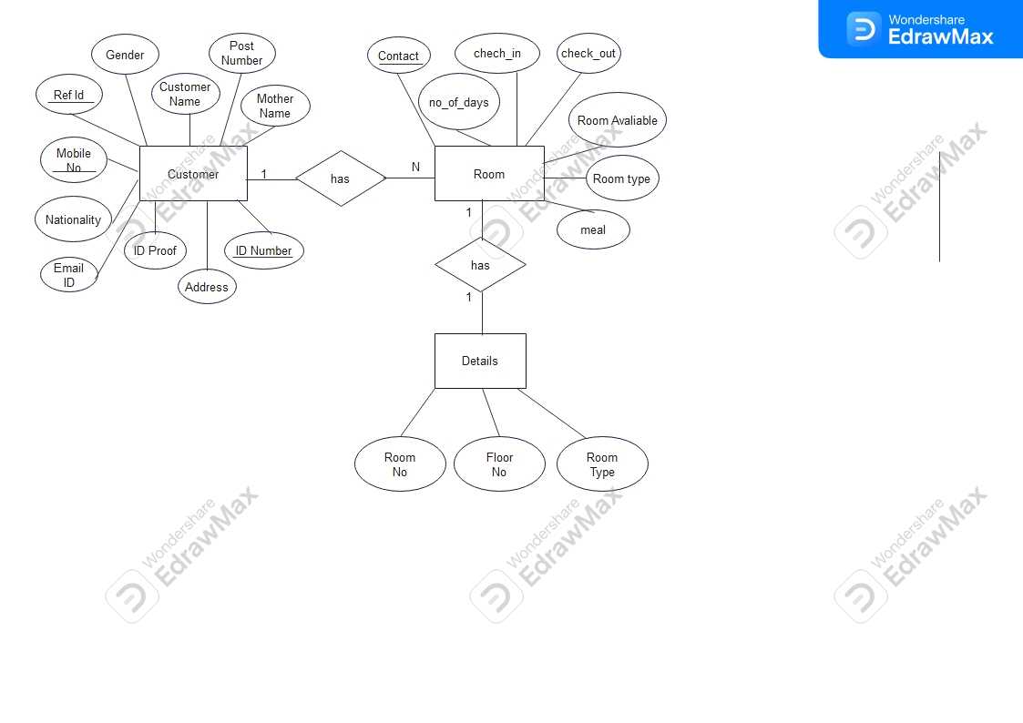
Hotel Management System ER Diagram

Slide 12

Use Case Diagram
For customer’s perspective:
Provide Personal information
Requirement of Room type
Requirement of Meal
Actors:
Customer
Employee
Manager
For Manager’s perspective
Logs in
Manage Room Details
Manage Room book details
Manage Customer Details
See Customer information
Check in available Room
For Employee perspective :
Check in available room
See Customer information
Logs in
Manage Customer details
Manage Room Book details

Slide 13
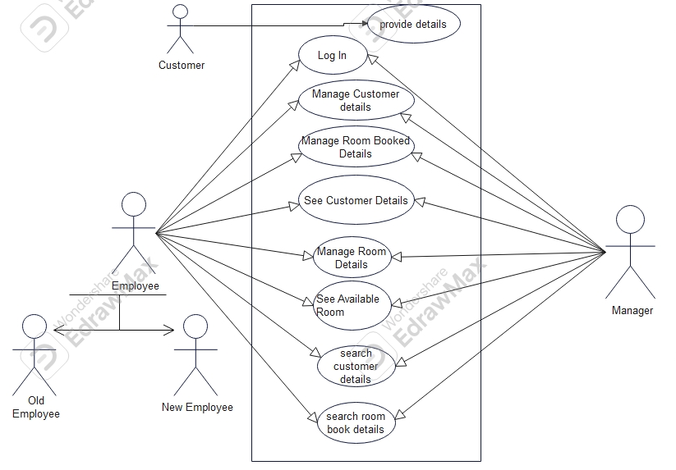
UCD of Hotel Management System

Slide 14
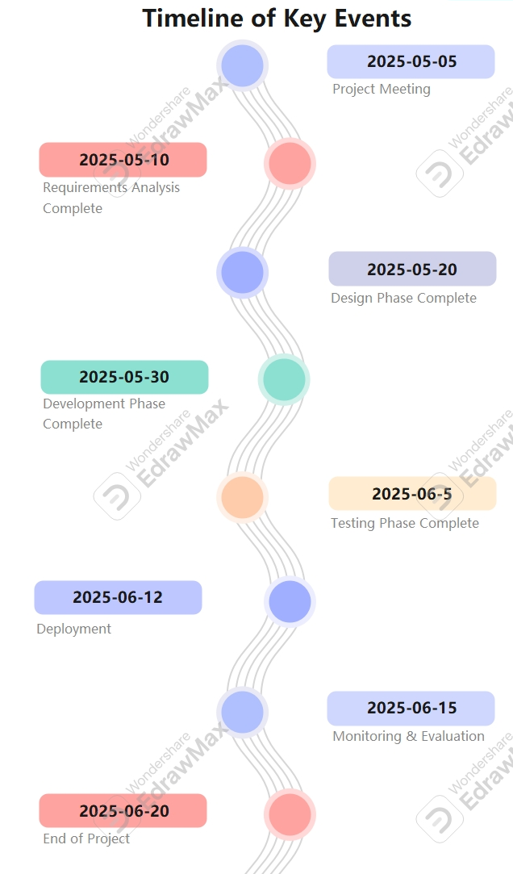
GANTT Chart

Slide 15

Tool Use:
1.VS Code
2.My SQL Workbench
3.Edrawmax
4.Powerpoint

Slide 16
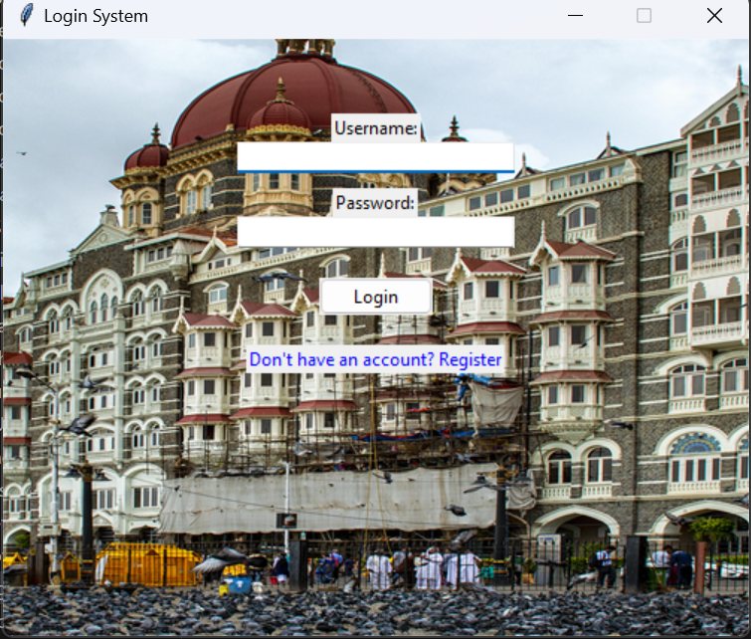

Slide 17
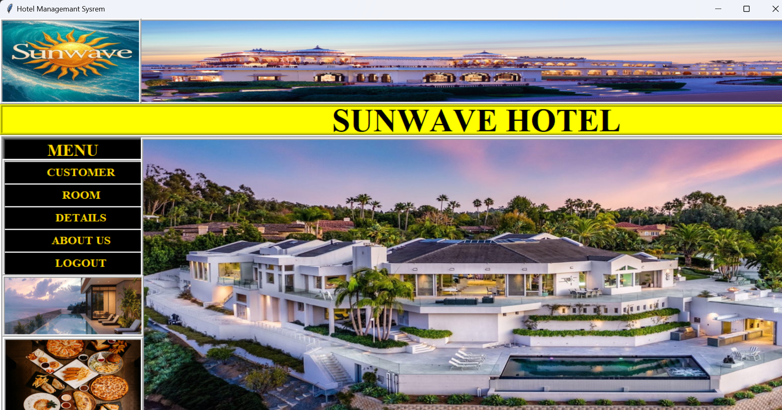

Slide 18
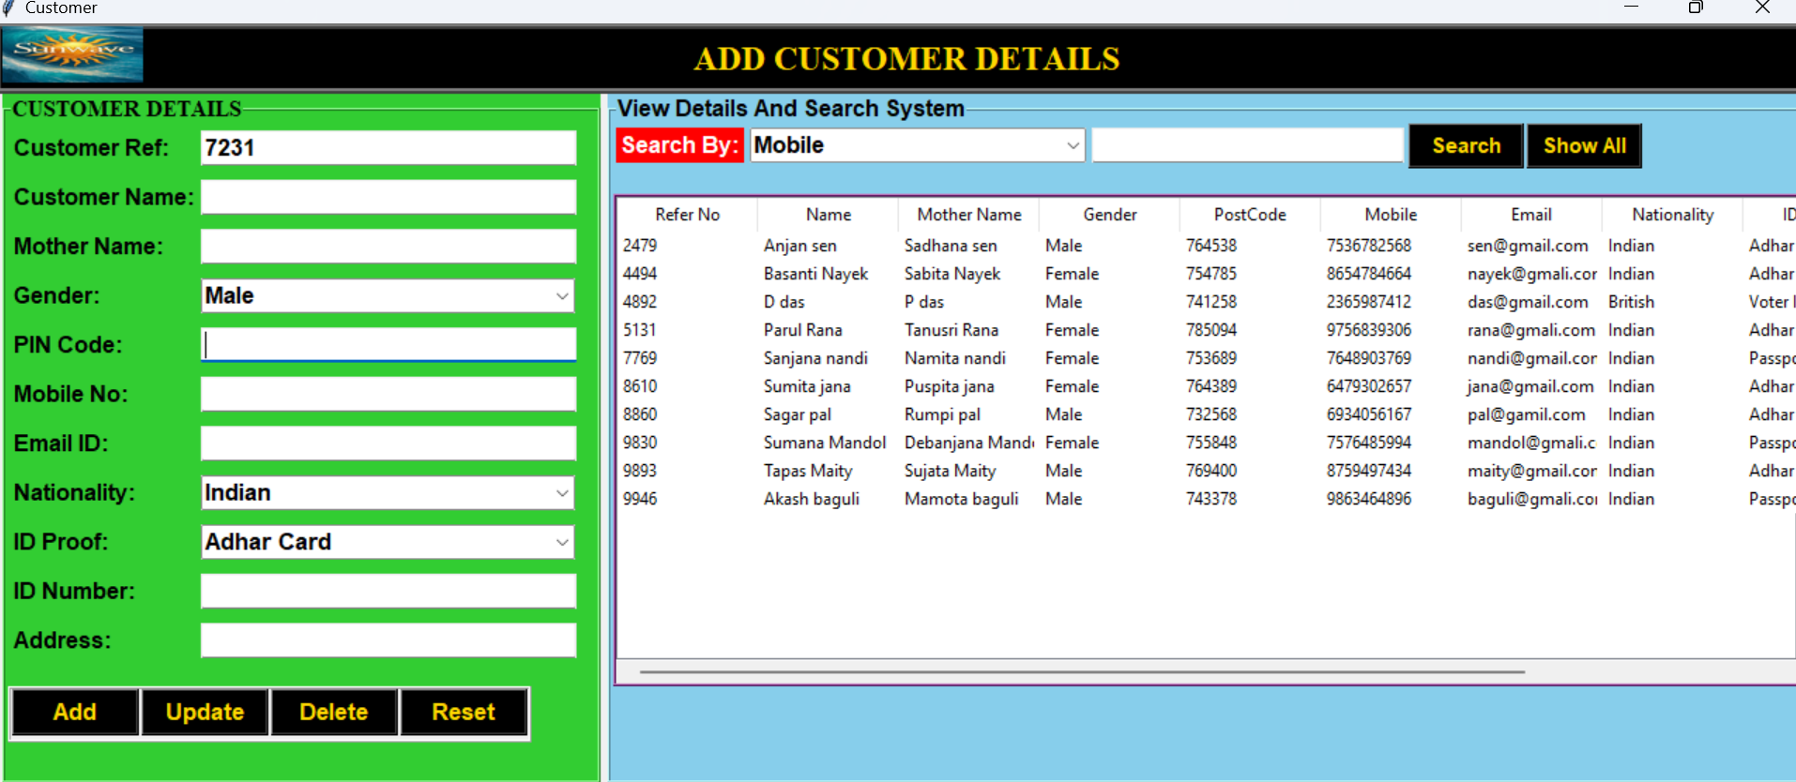

Slide 19
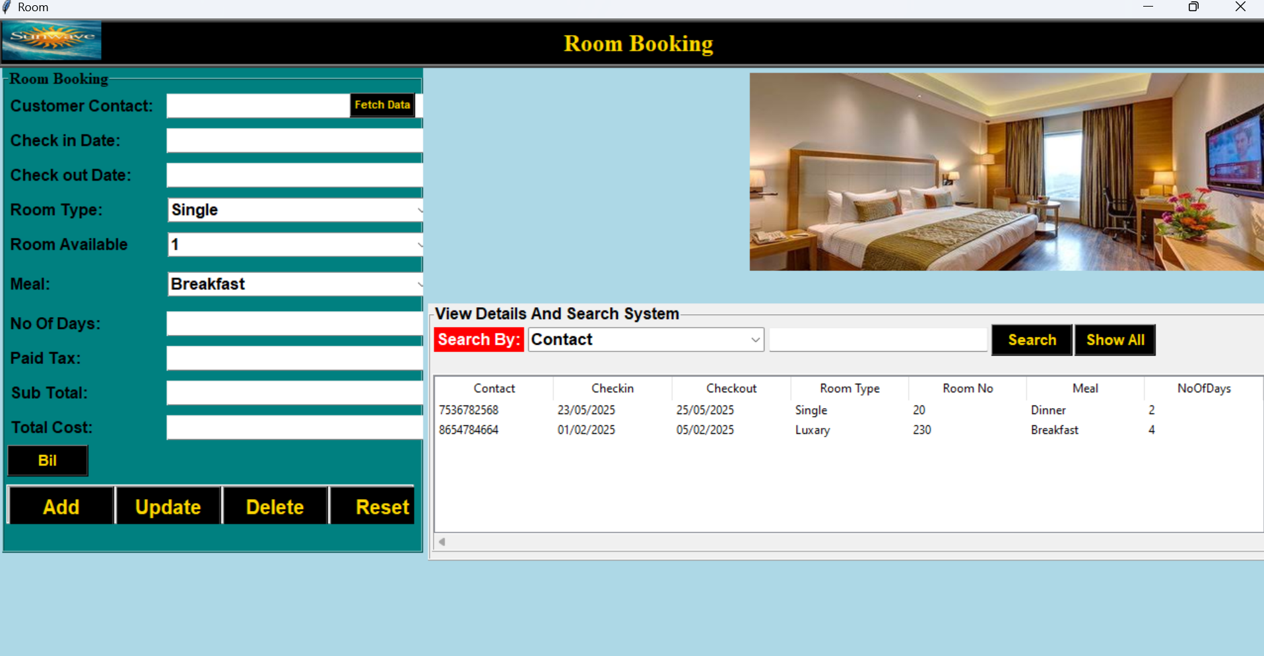

Slide 20
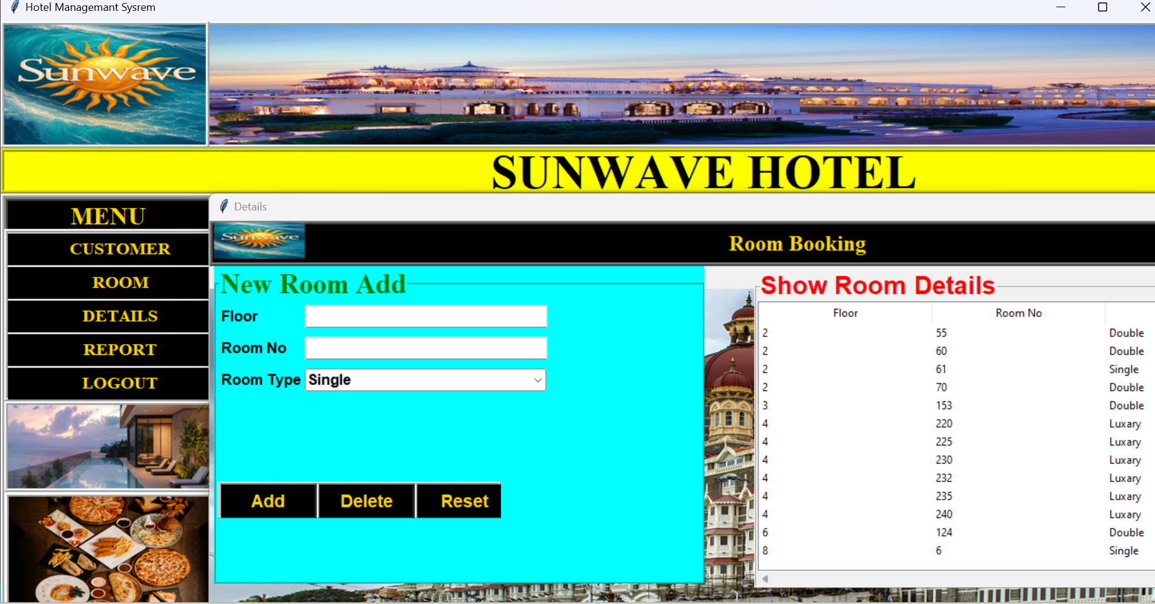

Slide 21
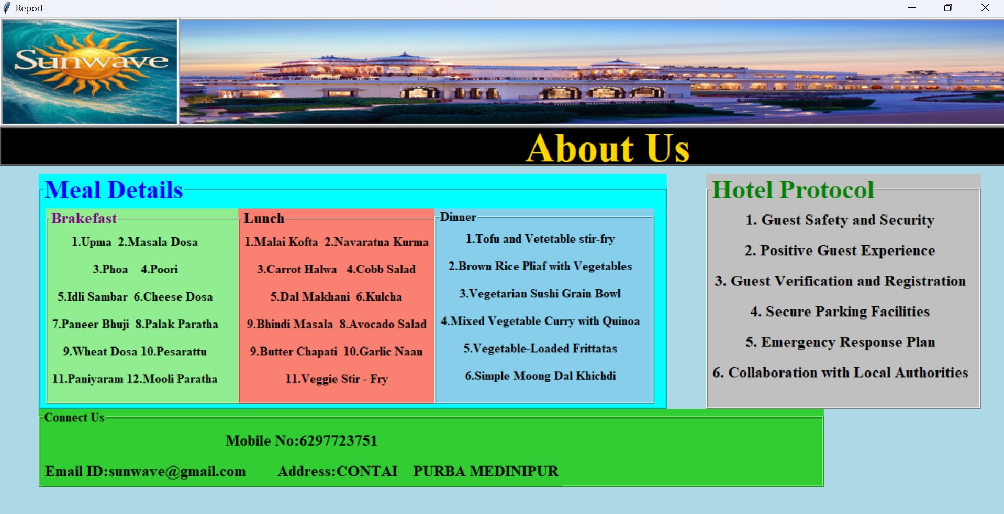

Slide 22


